Slide 1
Waterway-sunrise-i_657A

Slide 2
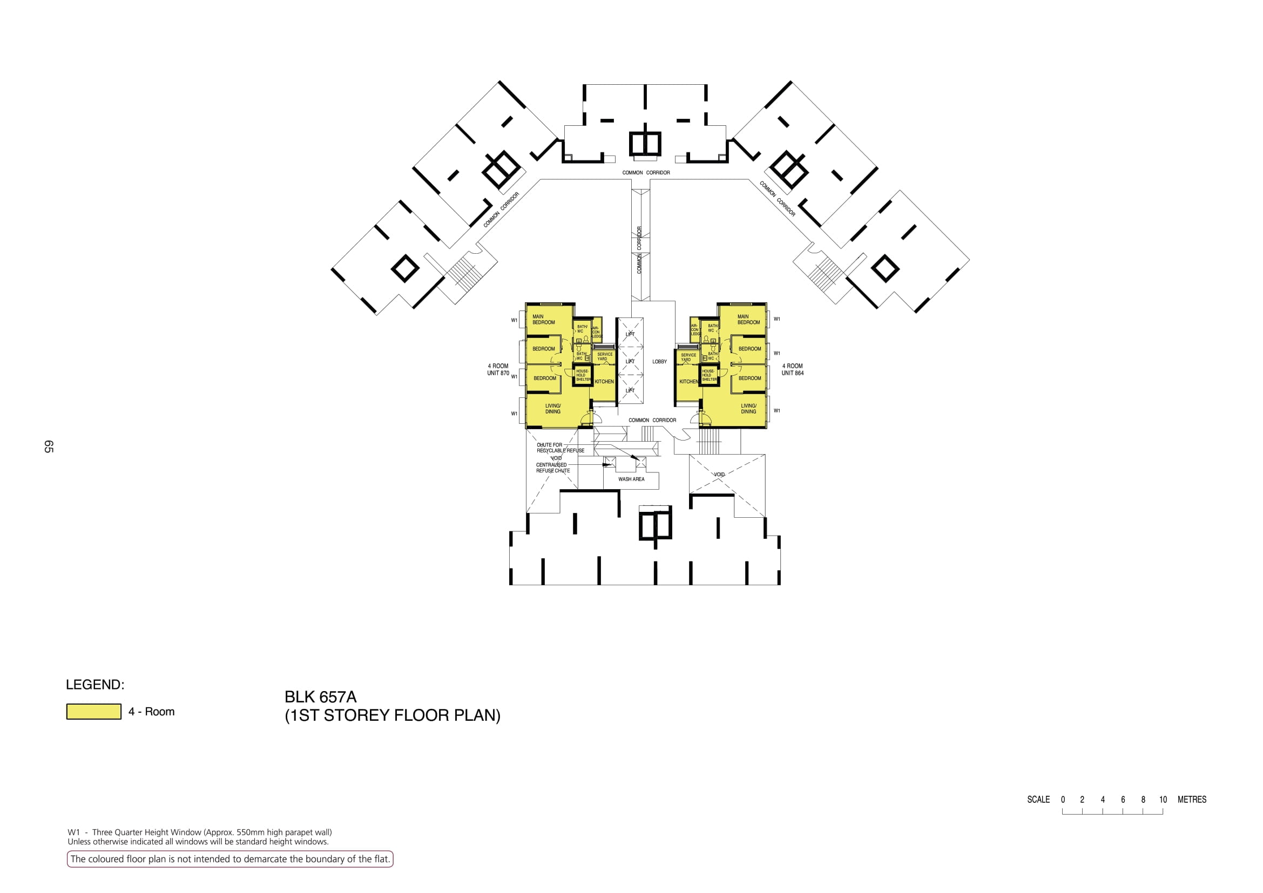

Slide 3
COMMON CORRIDOR
COMMON CORRIDOR
COMMON CORRIDOR
COMMON CORRIDOR
870
LOBBY
864
COMMON CORRIDOR
WASH AREA

Slide 4
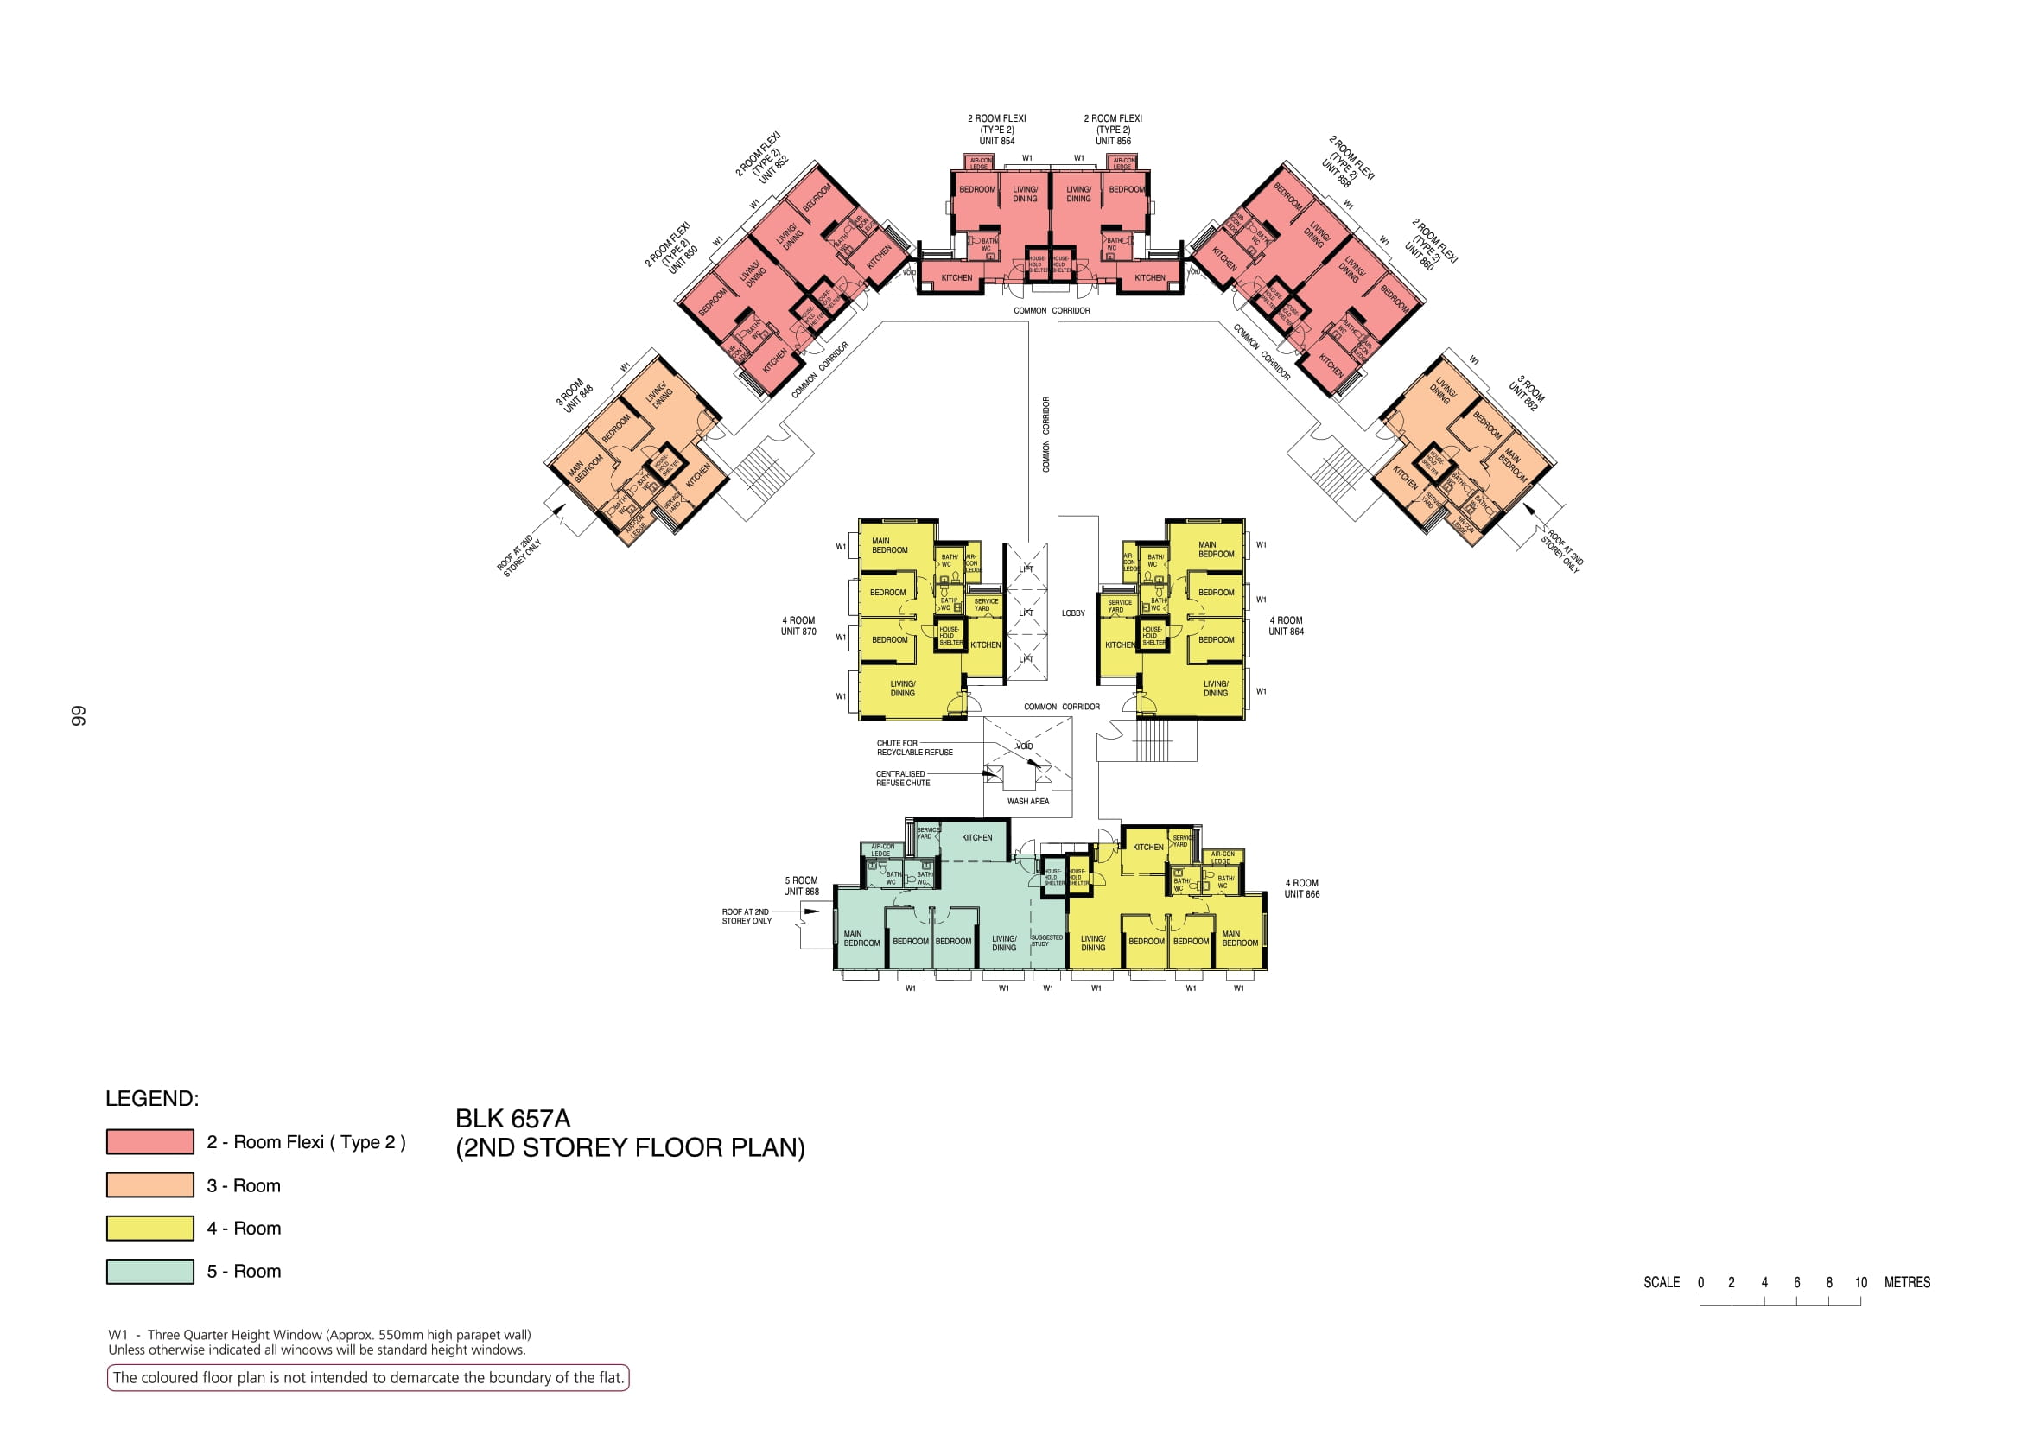

Slide 5
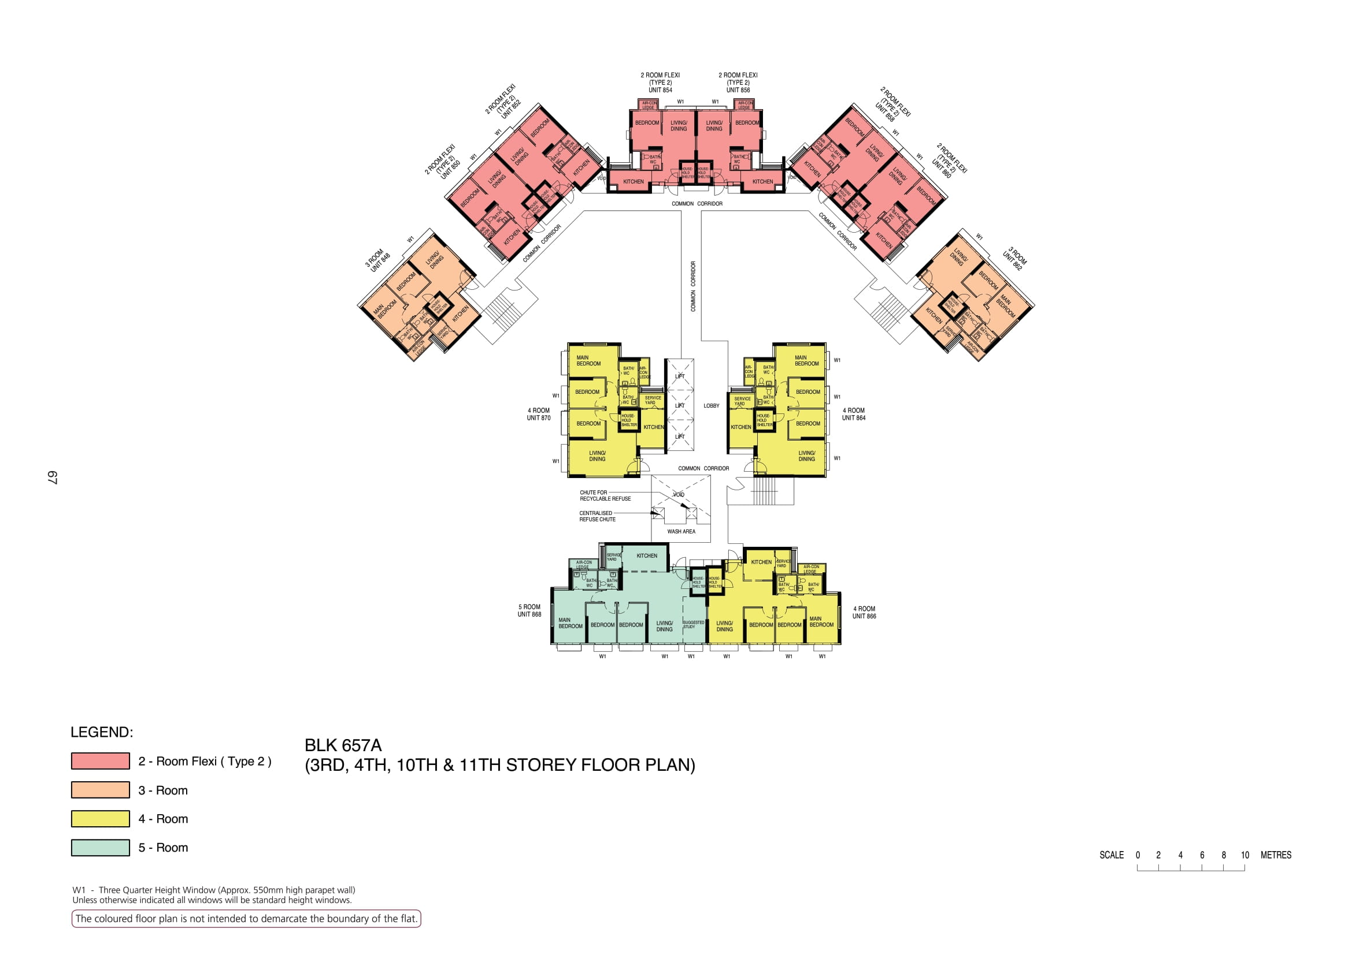

Slide 6


Slide 7


Slide 8


Slide 9
854
856
852
858
850
COMMON CORRIDOR
860
COMMON CORRIDOR
COMMON CORRIDOR
848
COMMON CORRIDOR
862
870
LOBBY
864
COMMON CORRIDOR
WASH AREA
868
866

